Slide 1
Principal Investigator: (Please type the name of the PI and the email).
Lab Advisor/Technician: (Please type the name of the lab technician and the email).
Department: (Please type the name of the department).
Contact information:
Phone: +962 6 5355000
Ext: (Please type the extension number of the department).
Email: (Please type the email of the department).
In case of emergency please call civil defense (911), the safety and environment office (21315), and university security (54).
في حالات الطوارئ يرجى ابلاغ الدفاع المدني على الرقم 911 ومكتب السلامة العامة والبيئة (21315) والامن الجامعي (54)
Notes:
On lab door (each lab)

Slide 2
On lab doors

Slide 3
On lab doors and elevators
Notes:
On lab doors and elevators

Slide 4
On lab doors
Lab Authorized Trained Personnel
Only
Notes:
On lab doors

Slide 5
Above the sink in each lab
Wah Your Hands Before Leaving the Lab
Notes:
Above the sink in each lab

Slide 6
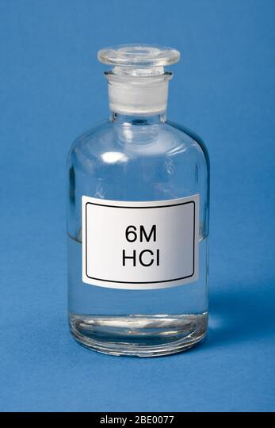
On a wall where lab personnel can see it clearly
Label Containers Properly
Labels should include the following:
Full name of the chemical.
Concentration.
Chemical hazard.
Chemical formula (optional).
Hydrochloric acid
Corrosive
Notes:
On a wall where personnel can see it clearly

Slide 7
On a wall where lab personnel can see it clearly
General Lab Safety
No food or drink in the lab.
No smoking.
Handle broken glassware carefully.
Hands should be washed with soap and water frequently throughout the day.
Hands should be washed after handling any hazardous materials, after the removal of gloves, and before leaving the laboratory.
Emergency exit should be clear.
Avoid mouth pipetting and use mechanical pipettes instead.
Place different lab wastes in their containers. Do not place them in the regular trash.
Pay attention to sharps in the lab. Do not place them in the regular trash.
Autoclave biological hazards before getting rid of them in the regular trash.
All containers should be labeled properly (even water should be labeled).
Notes:
On a wall where lab personnel can see it clearly

Slide 8
Near the fume hood
Proper Use of Fume Hood
Do
Make sure the fume hood is functioning properly.
Notify the lab technician if the fume hood is not functioning properly.
Keep the sash closed while not working.
Keep chemicals at least 6 inches (~5cm) inside the fume hood.
Notify the lab technician if the fume hood is not functioning properly.
Keep sash at 18 inches or less while working in the hood to protect from chemical splashes/fire/explosion.
Close the sash immediately after you finish your experiment. It will save energy and increase safety.
Remove spark sources or electrical units from the hood while working with flammable liquids or gases.
Perform routine maintenance.
Notes:
Near the fume hood

Slide 9
Near the fume hood
Proper Use of Fume Hood
Don’t
Don’t block the airflow.
Don’t store chemicals and equipment inside the fume hood.
Don’t place your head inside the fume hood while working.
Avoid fast movements of your hands inside the fume hood.
Avoid the traffic and fast movements in front of the fume hood.
Don’t remove the airfoil or the baffles.
Don’t use the fume hood sink for disposing of wastes.
Don’t open the sash completely while the experiment is in progress.
Don’t block the exhaust slot at the back of the fume hood.
Don’t allow excess chemicals to evaporate in the fume hood.
Notes:
Near the fume hood

Slide 10
Near the fume hood
Don’t open the sash completely.
Keep sash at 18 inches or less while working in the hood.
Don’t block the exhaust slot.
Don’t store chemicals inside the fume hood.
Notes:
Near the fume hood

Slide 11
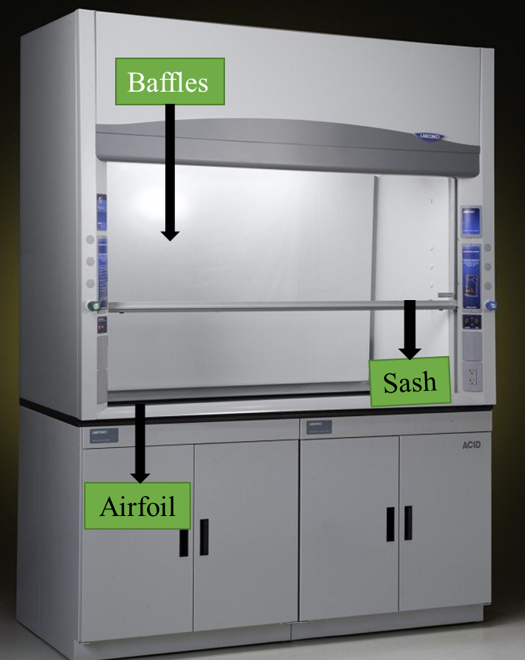
Near the fume hood
Notes:
Near the fume hood

Slide 12
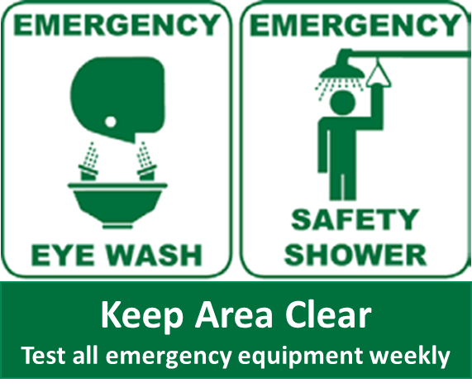
Near the eye wash station and the safety shower
Notes:
Near the eye wash station and the safety shower

Slide 13
Near the eyewash station
Eyewash Station
What to do in case your eyes are exposed to corrosive or injurious substances?
Immediately go to the eyewash station (the first 10-15 seconds postexposure are very critical).
Push the pedal to activate the eyewash.
Flush your eyes with the water.
Keep your eyes open using your fingers.
Gently roll your eyes in all directions to flush out chemicals.
Flush your eyes thoroughly for 15 minutes.
Notify your lab supervisor.
Seek medical help.
Maintaining Emergency Equipment:
Weekly activation of plumbed eyewashes is a must to make sure it is functional and have enough flushing fluid.
Annual testing of plumbed eyewashes is a must.
Notes:
Near the eye wash station

Slide 14
Near the safety shower
Safety Shower
What to do when your face and/or your body is exposed to corrosive or injurious substances?
Immediately go to the closest safety shower.
Pull the lever to allow the flow of water from the shower.
Stay under the water stream for at least 15 minutes or as long as possible until the arrival of the medical help.
Be careful not to allow the water stream from the safety shower to get into your eyes. It may cause damage to your eyes.
Notify the lab supervisor.
Seek medical help.
Careful: Don’t use the safety shower to wash your eyes.
The water stream from the safety shower can cause damage to your eyes.
In case your eyes and your body are exposed to corrosive or injurious substances, then use the eyewash station to thoroughly wash your eyes, and at the same time use the safety shower to wash your body.
Maintaining Emergency Equipment:
Periodically check the safety shower to ensure that access to the shower is not blocked.
Periodically inspect the safety shower visually to ensure that there are no broken parts or leakage.
Annual testing safety shower is a must.
Notes:
Near the safety shower

Slide 15
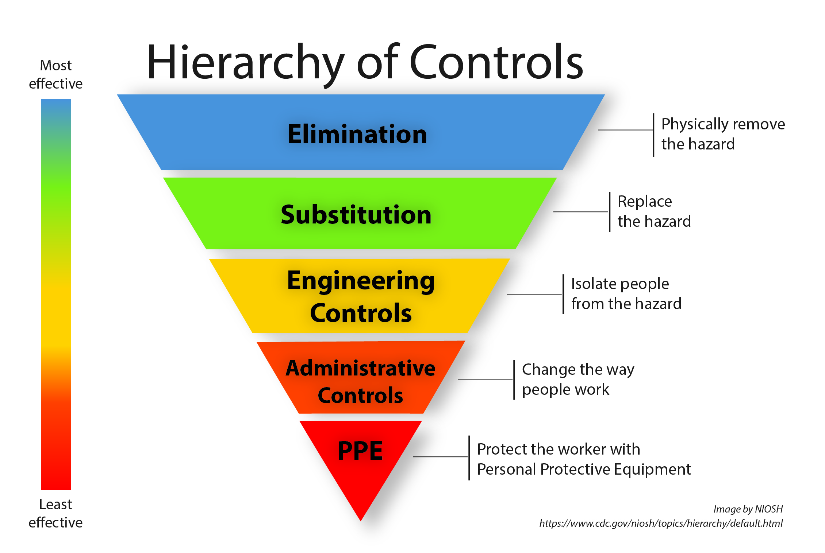
On a wall where lab personnel can see it clearly
Notes:
On a wall where lab personnel can see it clearly

